Slide 1
Presented by : Kishan Barochiya Batch no : Internship 22
FLIGHT PRICE PREDICTION MODEL

Slide 2

TOPICS WE ARE GOING TO COVERED
Problem Statement
Goal
Data explanation
Libraries used for EDA
EDA with conclusion
Final Conclusion for E-commerce portal

Slide 3
Problem Statement
Anyone who has booked a flight ticket knows how unexpectedly the prices vary. The cheapest available ticket on a given flight gets more and less expensive over time. This usually happens as an attempt to maximize revenue based on -
1. Time of purchase patterns (making sure last-minute purchases are expensive)
2. Keeping the flight as full as they want it (raising prices on a flight which is filling up in order to reduce sales and hold back inventory for those expensive last-minute expensive purchases)
So, you have to work on a project where you collect data of flight fares with other features and work to make a model to predict fares of flights.

Slide 4
GOAL
By doing EDA, we need to find out best factors which are helpful for e-commerce companies to maintain their relationships with customer for long term.
We will study and get solution for Age-wise Conclusion also because age wise factors are going to change

Slide 5
Data Explaination
We scraped the data from website yatra.com which one is the best portal where one can book their flights with best facilities and option like different companies, facilitates, stops, price, offers etc. We cleared this data and we have 10683 rows available with 11 columns or variables. We will clear that data first like null values, outliers, data types, duplicates etc then we will do EDA for it to understand data deeply and according to it proceed with data then pre- process data like scale down, feature selection then with the best data format we will feed it into model to check accuracy on testing dataset and on best 2 model we will go with hyper parameter tuning to increase accuracy at maximum level. Final step is to cross validation where we re-run all model 4 times and take it average score as final accuracy score. Highest accuracy contain model will dump as final best-fit model and then apply this model on unknown model to check accuracy.

Slide 6
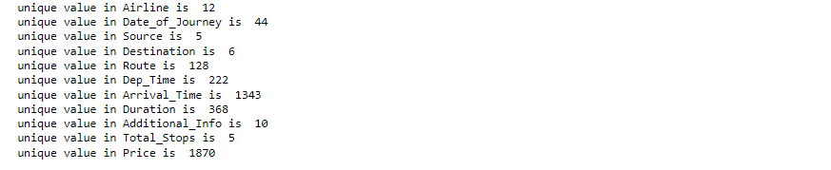
Statatics of Dataset
Shape of data: 10683 Rows and 11 columns
Null values in columns: 2 null values
Data types of columns: 10 columns have object dtype and 1 have int

Slide 7
Assumption
We convert day and from ‘date of journey’ and drop original column.
We convert dept column in 5 zone like early morning, morning, afternoon, evening and late night with reference to dept time.

Slide 8
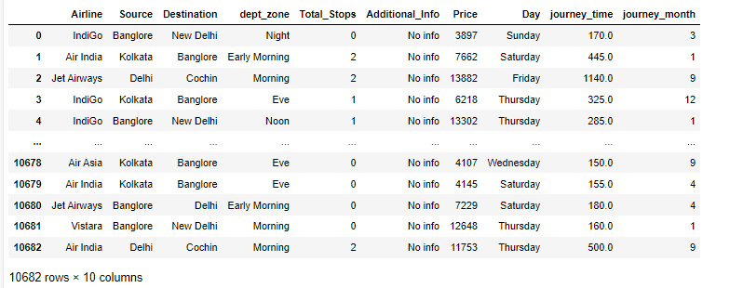
Data format before EDA

Slide 9
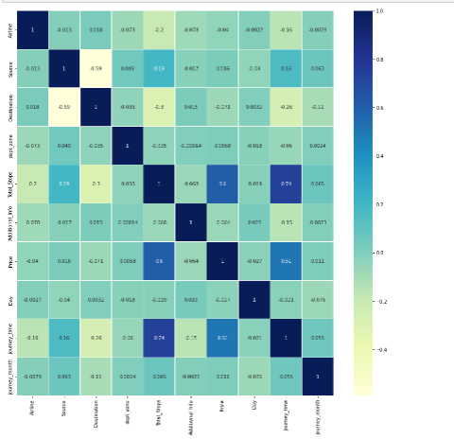
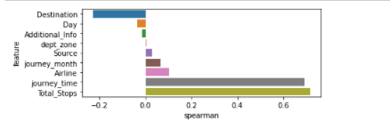
EDA

Slide 10
EDA CONCLUSION
1) Price is directly effective with Journey time and total stops.
2) Total stops is inversly co-related with journey time.
3) Source have co-relation with stops and journey time as distance increase then travelling time also increase and total stops also may be increase.
4) Journey month and journey day have no much co-relation with any variable

Slide 11
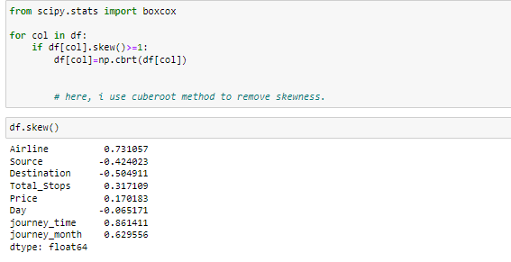
DATA PRE_PROCESSING
Skewness removel:
We used Cuberoot method to remove skewness.

Slide 12
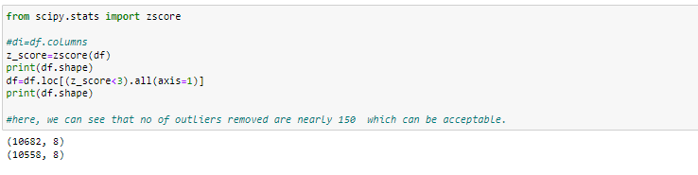
Z-score technique to remove outliers from dataset

Slide 13
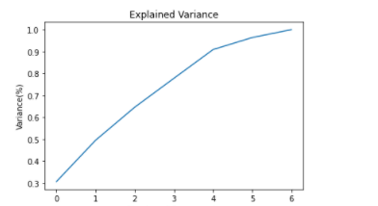
FEATURE SELECTION
PCA: we use this method to get best features where we can check at how many features we can cover maximum variance.

Slide 14
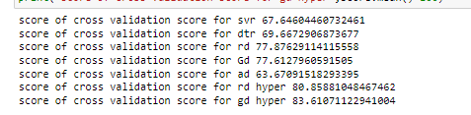
MODEL BUILDING
We are getting higher accuracy in gradient boosting regressor with hyper parameter tuned model as per snap:

Slide 15
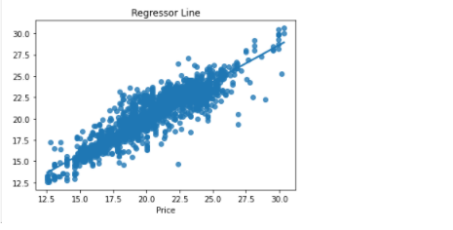
Final prediction result

